Slide 1
Chapter 2. Statistical Foundations
Financial Econometrics
Department of financial engineering
Zhongnan university of economics and law
Xu Yonghao

Slide 2
oUTLINE
Summary Statistics
Graphics
Group Comparison
Merge

Slide 3
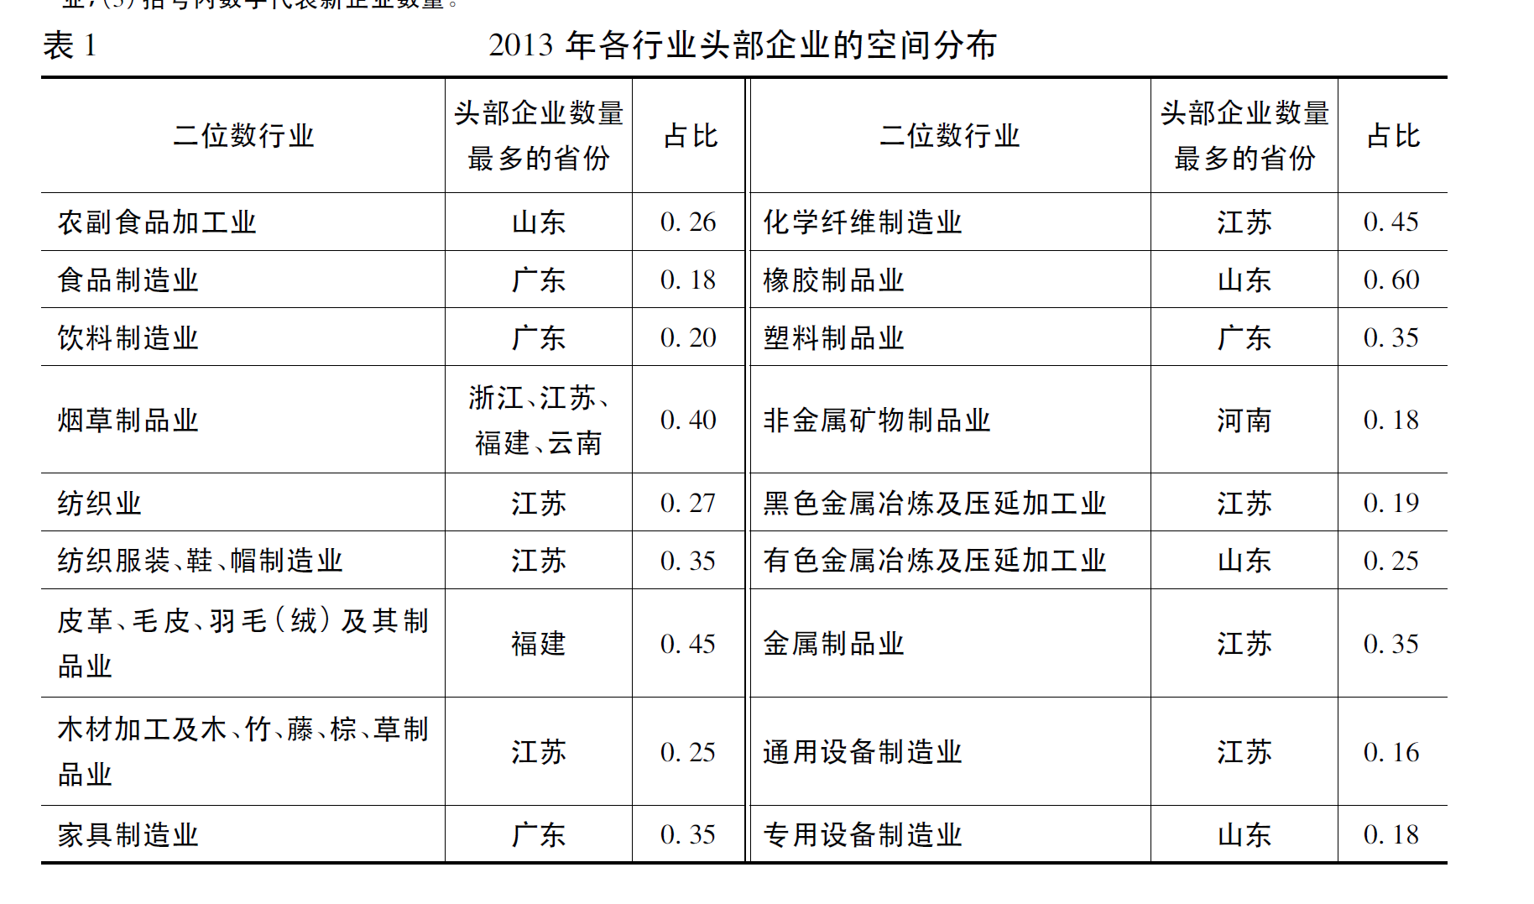
1 Summary Statistics
[1]范剑勇,刘念,刘莹莹.地理距离、投入产出关系与产业集聚[J].经济研究,2021,56(10):138-154.

Slide 4
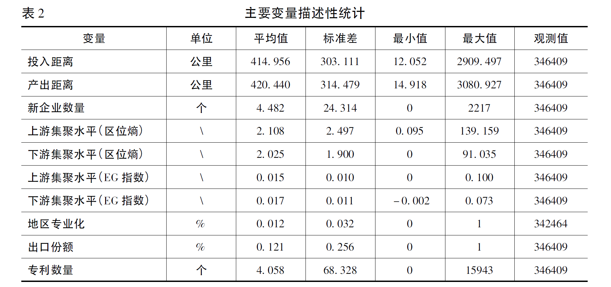
1 Summary Statistics
[1]范剑勇,刘念,刘莹莹.地理距离、投入产出关系与产业集聚[J].经济研究,2021,56(10):138-154.

Slide 5
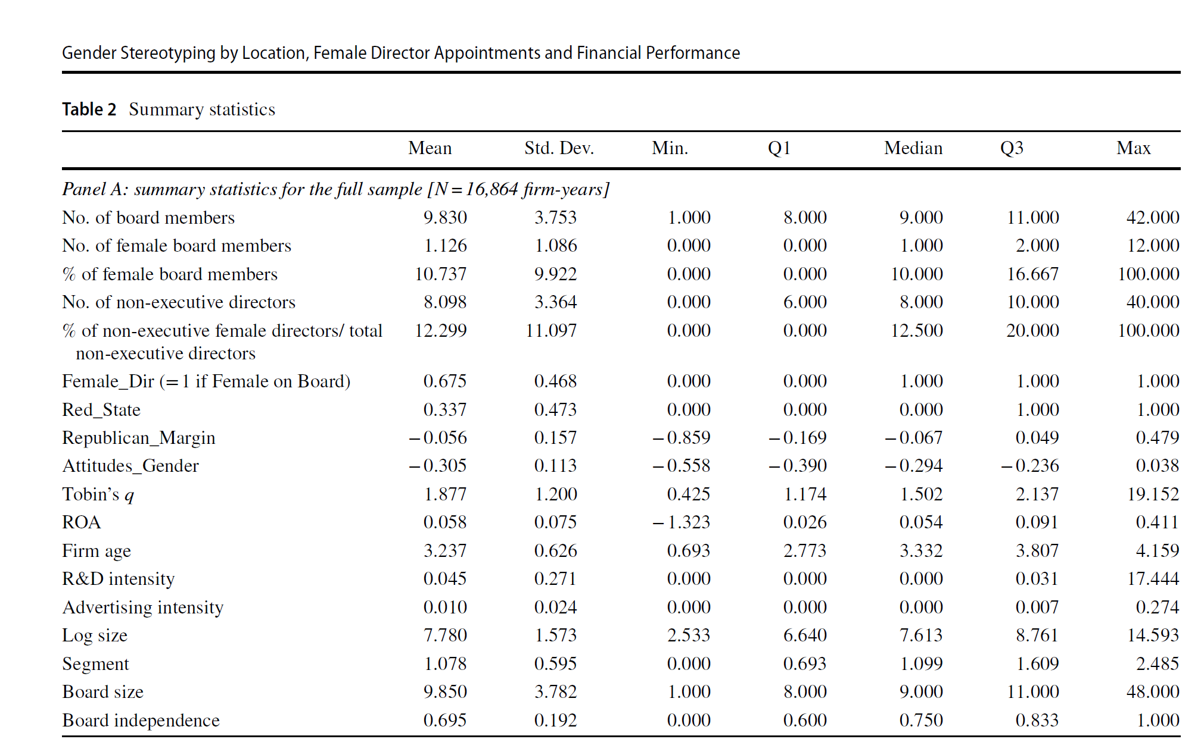
1 Summary Statistics
Compton Y L, Kang S H, Zhu Z. Gender stereotyping by location, female director appointments and financial performance[J]. Journal of Business Ethics, 2019, 160(2): 445-462.

Slide 6
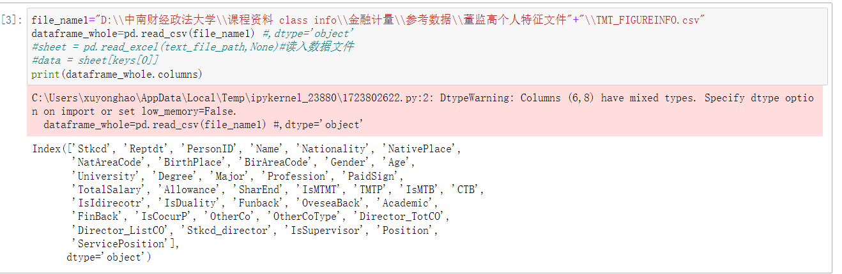
1 Summary Statistics – Read data

Slide 7
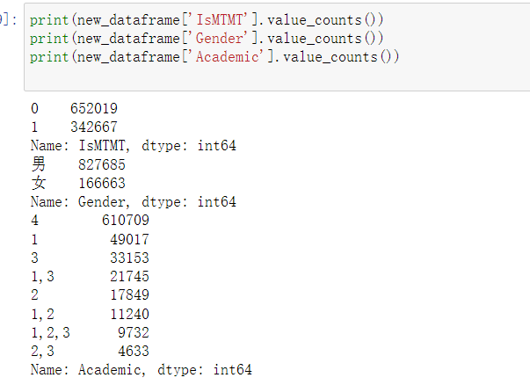
1 Summary Statistics – Read data

Slide 8
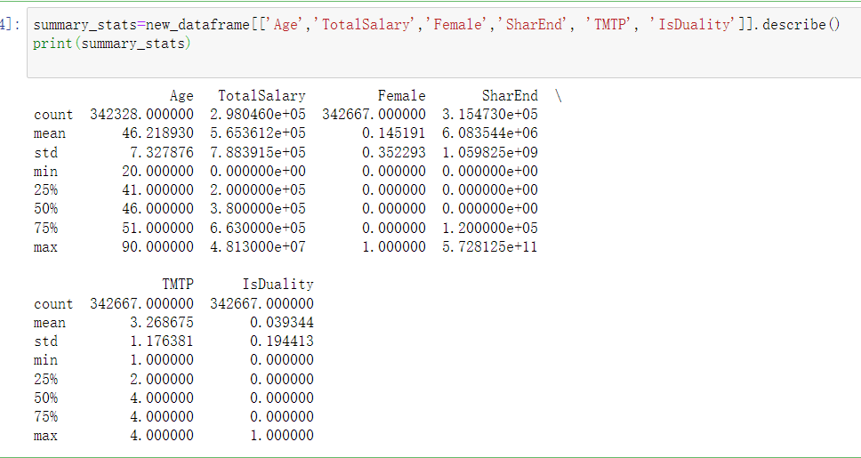
1 Summary Statistics - Summary

Slide 9
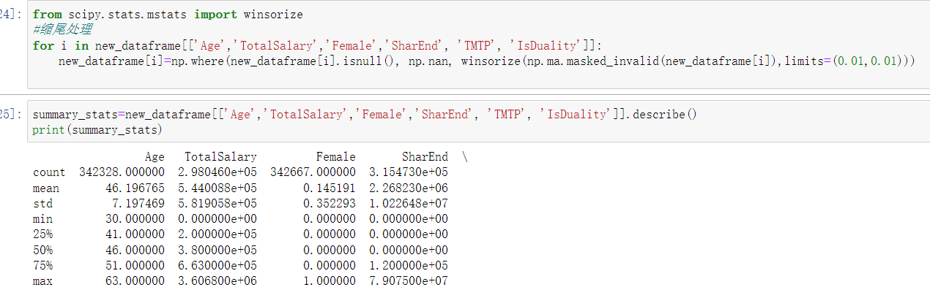
1 Summary Statistics - winsorize
Save summary stats in excel

Slide 10
1 Summary Statistics - Summary
Save summary stats in excel

Slide 11
1 Summary Statistics
index | count | mean | std | min | 25% | 50% | 75% | max
Age | 342328 | 46.19676 | 7.197469 | 30 | 41 | 46 | 51 | 63
TotalSalary | 298046 | 544008.8 | 581905.8 | 0 | 200000 | 380000 | 663000 | 3606800
Female | 342667 | 0.145191 | 0.352293 | 0 | 0 | 0 | 0 | 1
SharEnd | 315473 | 2268230 | 10226476 | 0 | 0 | 0 | 120000 | 79075000
TMTP | 342667 | 3.268675 | 1.176381 | 1 | 2 | 4 | 4 | 4
IsDuality | 342667 | 0.039344 | 0.194413 | 0 | 0 | 0 | 0 | 1

Slide 12
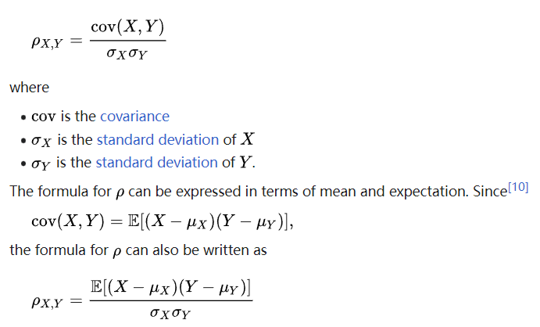
1 Summary Statistics - correlation
In statistics, the Pearson correlation coefficient (PCC) is a correlation coefficient that measures linear correlation between two sets of data. It is the ratio between the covariance of two variables and the product of their standard deviations; thus, it is essentially a normalized measurement of the covariance, such that the result always has a value between −1 and 1.

Slide 13
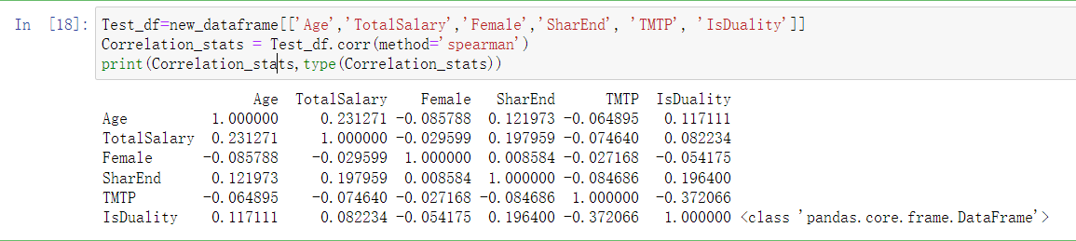
1 Summary Statistics - correlation

Slide 14
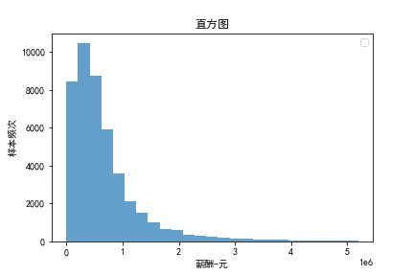
2.1 Graphics - histogram
A histogram is a graph that shows the frequency of numerical data using rectangles. The height of a rectangle (the vertical axis) represents the distribution frequency of a variable (the amount, or how often that variable appears).

Slide 15
2.1 Graphics - histogram
A histogram is a graph that shows the frequency of numerical data using rectangles. The height of a rectangle (the vertical axis) represents the distribution frequency of a variable (the amount, or how often that variable appears).

Slide 16
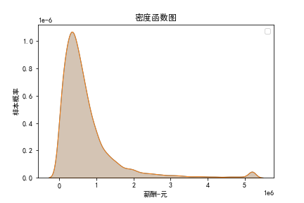
2.1 Graphics - density
A density plot is a representation of the distribution of a numeric variable. It uses a kernel density estimate to show the probability density function of the variable (see more).

Slide 17
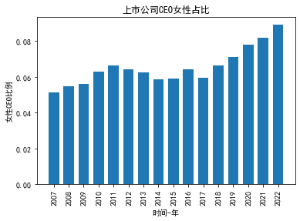
2.2 Graphics - Bar

Slide 18
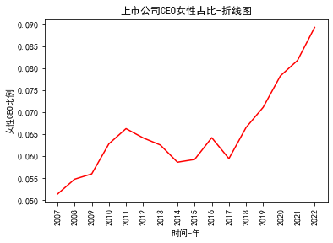
2.3 Graphics - line

Slide 19
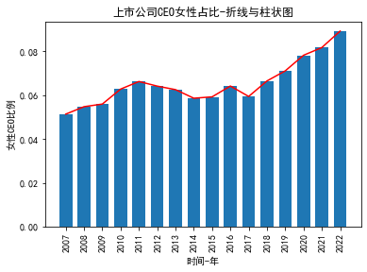
2.4 Graphics– BAR with line

Slide 20
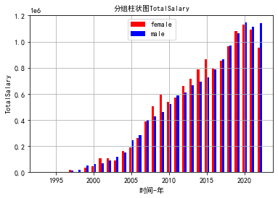
2.5 Graphics – Group Comparison

Slide 21
3 Group Comparison
Student’s t-test, in statistics, a method of testing hypotheses about the mean of a small sample drawn from a normally distributed population when the population standard deviation is unknown.
In 1908 William Sealy Gosset, an Englishman publishing under the pseudonym Student, developed the t-test and t distribution. (Gosset worked at the Guinness brewery in Dublin and found that existing statistical techniques using large samples were not useful for the small sample sizes that he encountered in his work.) The t distribution is a family of curves in which the number of degrees of freedom (the number of independent observations in the sample minus one) specifies a particular curve. As the sample size (and thus the degrees of freedom) increases, the t distribution approaches the bell shape of the standard normal distribution. In practice, for tests involving the mean of a sample of size greater than 30, the normal distribution is usually applied.

Slide 22
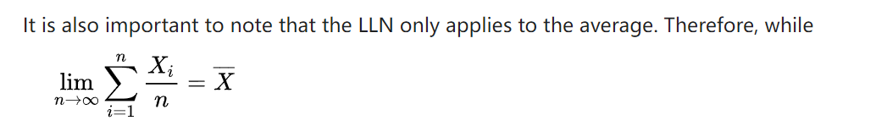
3.1 law of large numbers (LLN)
In probability theory, the law of large numbers (LLN) is a theorem that describes the result of performing the same experiment a large number of times. According to the law, the average of the results obtained from a large number of trials should be close to the expected value and tends to become closer to the expected value as more trials are performed

Slide 23
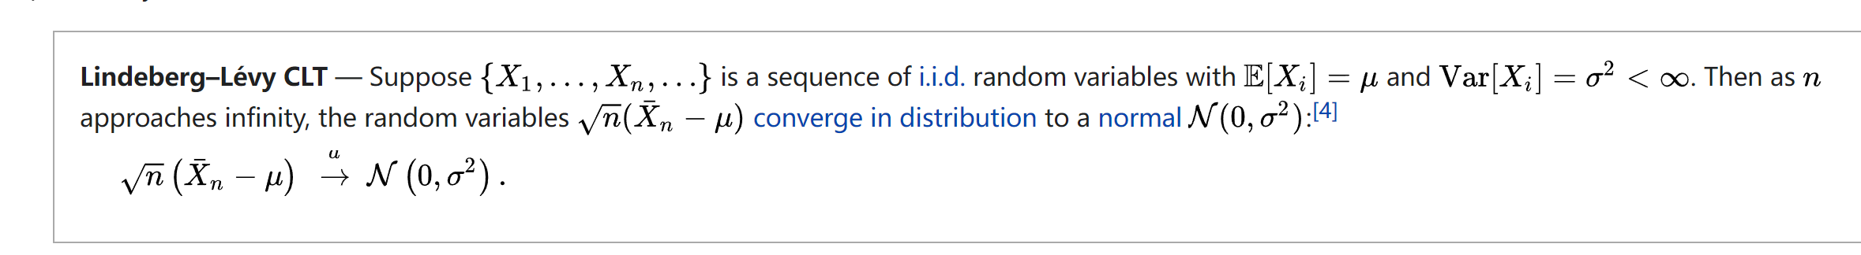
3.2 central limit theorem (CLT)
In probability theory, the central limit theorem (CLT) establishes that, in many situations, when independent random variables are summed up, their properly normalized sum tends toward a normal distribution even if the original variables themselves are not normally distributed.

Slide 24
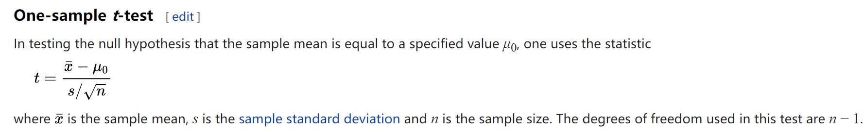
3.3 student-ttest

Slide 25
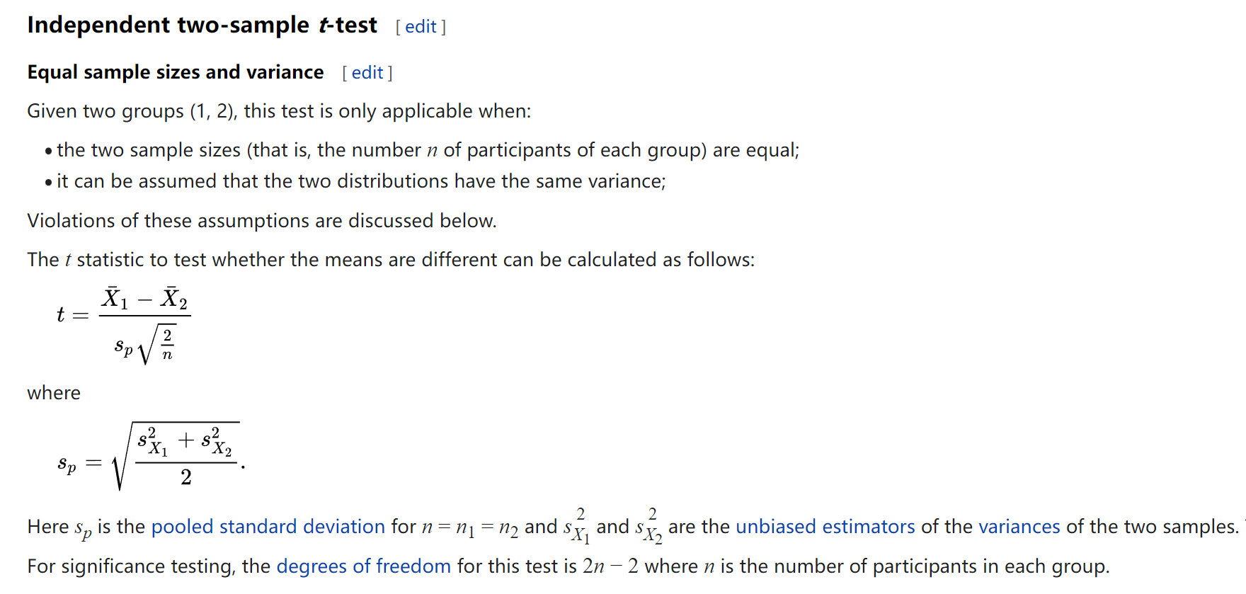
3.3 student-ttest

Slide 26
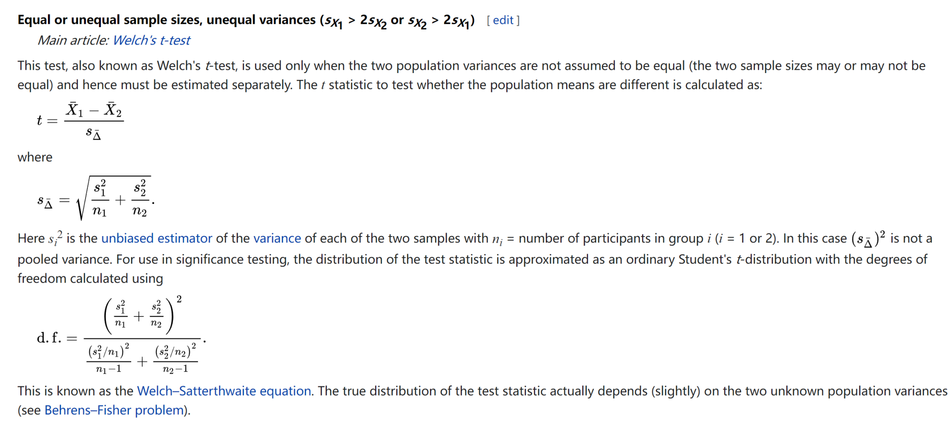
3.3 student-ttest

Slide 27
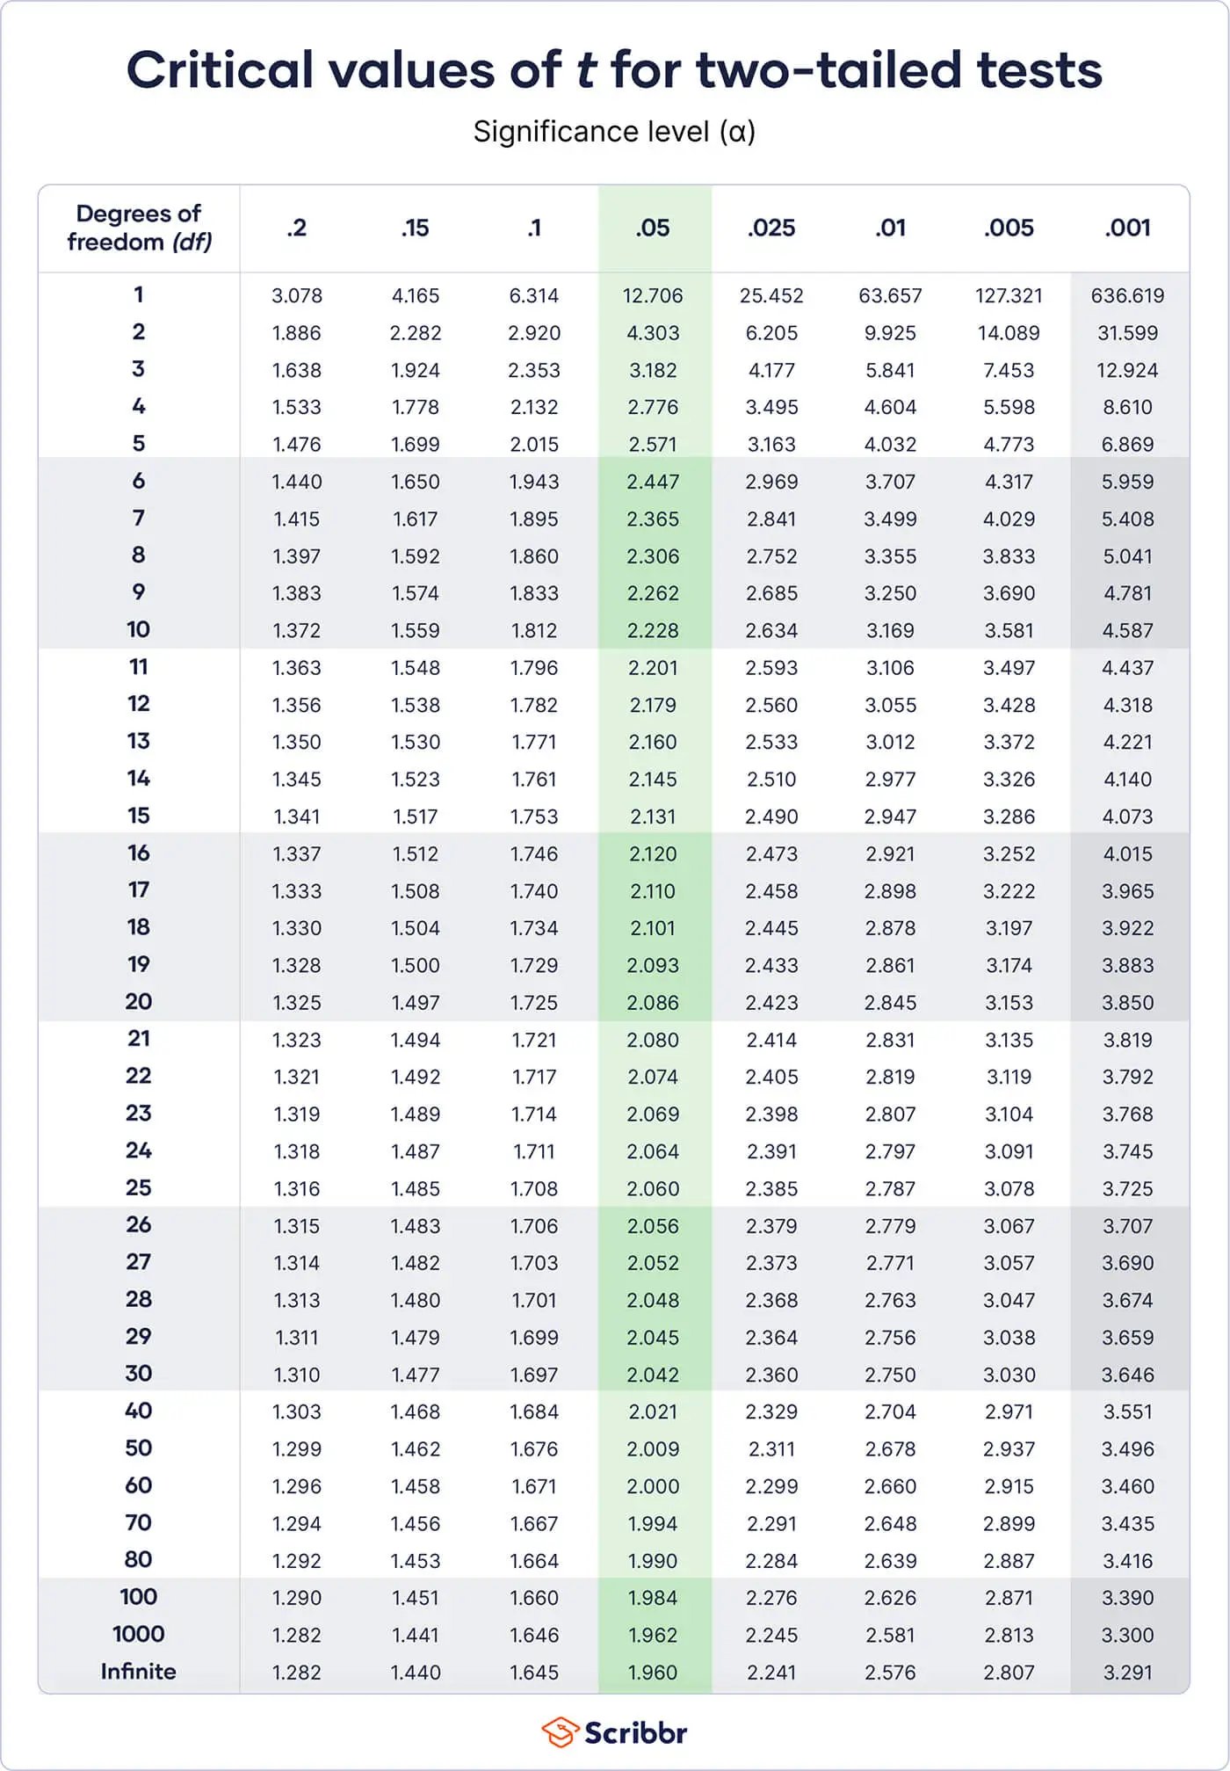
3.3 student-ttest

Slide 28
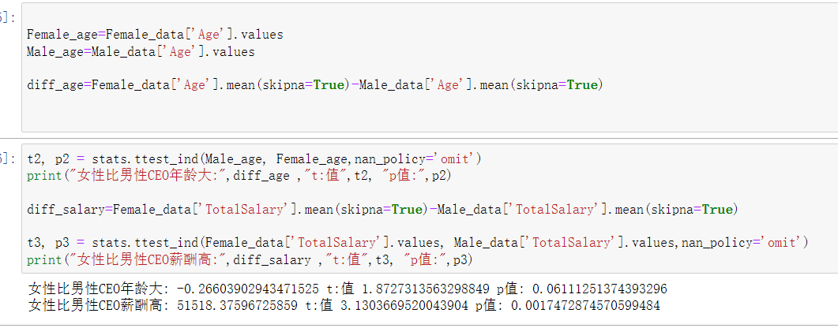
3.3 student-ttest

Slide 29
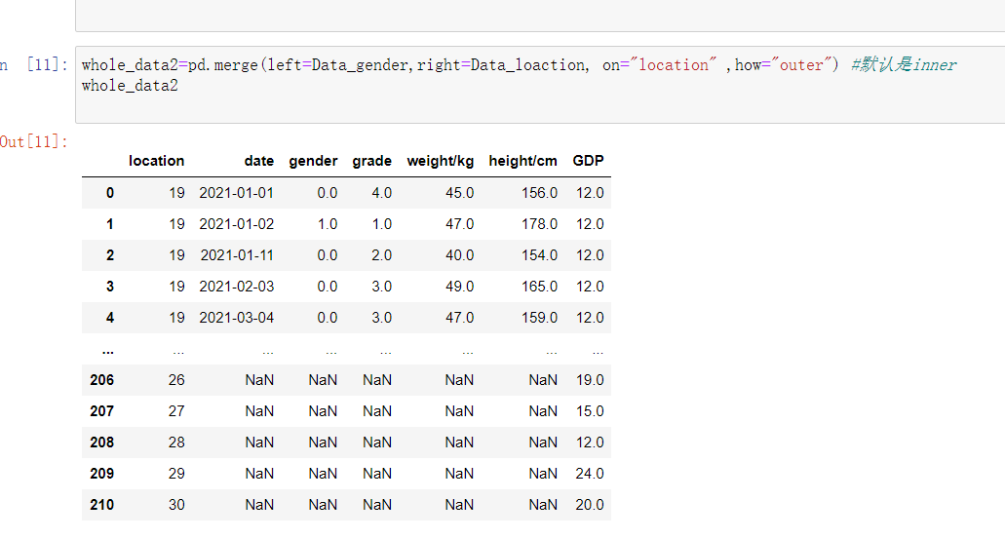
4 Merge

